Slide 1

“The Art of Poetry”
“Exploring the Beauty and Depth of Poetic Expression”

Slide 2

Introduction to Poetry
Definition of Poetry:Poetry is a literary form that uses aesthetic and rhythmic qualities of language to evoke meanings beyond prose.Brief History:Originated in ancient cultures (e.g., Sumerian, Egyptian).Evolved through various periods: Classical, Medieval, Renaissance, Romantic, Modern, and Contemporary.

Slide 3
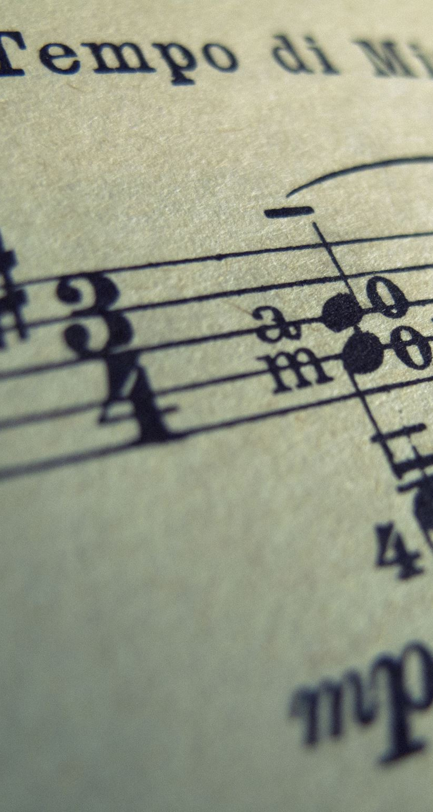
Types of Poetry
Overview of Various Forms:Sonnets: 14-line poems with a specific rhyme scheme.Haikus: Three-line poems (5-7-5 syllable pattern) originating from Japan.Free Verse: Poetry without regular rhyme or rhythm.Limericks: Humorous five-line poems with a specific meter and rhyme scheme.

Slide 4

Famous Poets
Notable Poets:Robert Frost: Known for themes of nature and rural life.Maya Angelou: Celebrated for her powerful voice on social issues and personal identity.Rumi: A 13th-century Persian poet known for his mystical and spiritual poetry.Contributions: Highlight significant works or achievements of each poet.

Slide 5

Elements of Poetry
Key Elements:Meter: The rhythmic structure of the poem.Rhyme: The pattern of sounds at the end of lines.Imagery: Descriptive language that appeals to the senses.Symbolism: The use of symbols to represent ideas or qualities.Contribution to Meaning: Each element enhances the emotional and intellectual depth of the poem.

Slide 6
Themes in Poetry
Common Themes:Love: Explored in various forms, from romantic to platonic.Nature: Reflections on the beauty and power of the natural world.Death: Contemplations on mortality and the afterlife.Identity: Exploration of self, culture, and societal roles.Examples: Mention specific poems that exemplify these themes, such as “The Road Not Taken” by Frost for choice and reflection.

Slide 7

The Writing Process
Steps in Writing Poetry:Brainstorming: Gather ideas and themes.Drafting: Write down thoughts without worrying about form.Revising: Refine language, structure, and imagery.Tips for Aspiring Poets:Read widely for inspiration.Experiment with different styles and forms.Share your work for feedback.

Slide 8

Analyzing Poetry
Techniques for Analyzing Poems:Read Aloud: Experience the rhythm and sound.Identify Themes and Tone: Understand the underlying messages and emotions.Examine Structure: Look at stanza arrangement, line breaks, and punctuation.Importance of Context: Consider historical and personal context to enrich understanding.

Slide 9

Poetry in Different Cultures
Overview of Global Poetry:Asian Poetry: Rich traditions in haikus and ghazals.African Poetry: Emphasis on oral tradition and storytelling.European Poetry: Diverse forms, from Greek epics to modernist works.Unique Characteristics: Discuss cultural influences on poetic expression.

Slide 10
Modern Poetry
Contemporary Poets and Trends:Highlight poets like Amanda Gorman or Ocean Vuong.Discuss the rise of spoken word and performance poetry.Impact of Social Media: Platforms like Instagram and TikTok have changed how poetry is shared and consumed.

Slide 11

The Role of Poetry in Society
Social Issues Addressed:Poetry as a tool for activism (e.g., LGBTQ+ rights, racial equality).The therapeutic role of poetry in mental health and community expression.Significance of Poetic Expression: Poetry can inspire change, provoke thought, and foster connection.

Slide 12

Conclusion
Recap of the Significance of Poetry:Emphasize poetry’s ability to connect people and express complex emotions.Engagement Invitation:Encourage the audience to share their favorite poems or poets and discuss what poetry means to them.

